Slide 1

Dairy Digitization Presentation

Slide 2

Agenda
01
Corporate Overview
02
SAP Capability Overview
03
SAP AMS Capability Overview
04
SAP Case Studies
05
SAP S/4HANA Preconfigured Solution for Dairy Industry
06
Wrap Up

Slide 3



Who We Are
CLIENTELE
PARENT COMPANY & BOD CoS.
EMPLOYEE STRENGTH
CLIENTELLE
  300+ Overall clients
  120+ Active Clients
  15+ Ongoing Development Projects
  35+ Ongoing Maintenance Projects
  45+ Active T&M Engagements with > 20 consultants
  Established 2001
  5 Acquisitions in last 2 years
  $170 Million 2019 projected
  Across 6 countries - multiple locations
    USA
    India
    Malaysia
    Bangladesh
    UAE
    Australia
29-08-2019
www.lorhanit.com | © Lorhan IT 2019
3

Slide 4



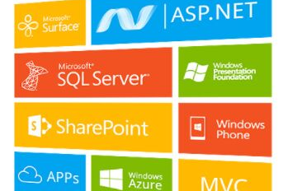
Practice and Solutions
CLIENTELLE
EMPLOYEES
  200+ SAP Implementations
  25 S4 HANA Implementations
  13+ Industry Domain Expertise
  10+ Industry Add ONs
  40+ SAP Active AMS Engagements
  65% of clients > 7Yr relations.
  mongo DB partner
  10+ Clients Across US
  100% Certified mongo DB Professionals
  25+ mongo DB Administrators
  Cloud mongo DB Expertise
  3+ Active Development SOW’s - 130+ resources
  2 major airline Development engagements
  Employees in Australia and India
  45+ employees supporting pharmaceutical company development & maintenance
  Certified Oracle Partner
  Employees across Middle East, USA, and India
  30+ on Hyperion Experts across Globe
  Actively supporting 4 clients
29-08-2019
www.lorhanit.com | © Lorhan IT 2019
4

Slide 5
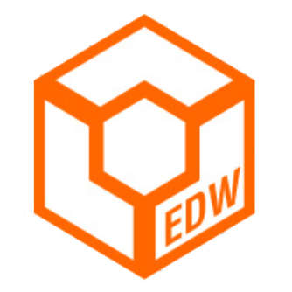
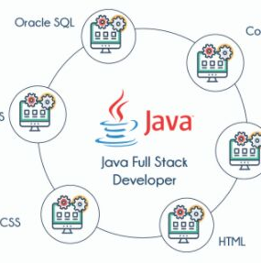




Managed Services and Consultants
CLIENTELLE
EMPLOYEES
  300+ T&M Consultants deployed in USA across
    IBM Infosphere,
    Datastage,
    Informatica,
    Ab Initio,
    Big Data
  25+ Data Analysis and Business Intelligence
  40+ Active Clients
  105+ Full stack Java Developers
  65+ UI Experts
  Active Android and IOS development engagements
  Active chatbot Engagement for an Airline Industry
  Certified Blockchain architects – 2 ongoing studies
  1-Click Cloud CI/CD/CV practice
    Zero Downtime
    Blue – Green Deployments
  Active QA managed services
  150+ Selenium Developers
  Automation Framework solution
    Automated TDM
    JIRA Integration
    Shift Left to Shift Right
29-08-2019
www.lorhanit.com | © Lorhan IT 2019
5

Slide 6

Global Clients
EMPLOYEES
29-08-2019
www.lorhanit.com | © Lorhan IT 2019
6

Slide 7



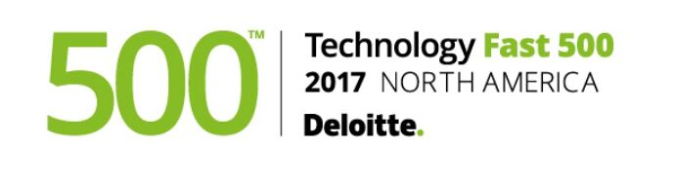




Awards and Recognition
EMPLOYEES
29-08-2019
www.lorhanit.com | © Lorhan IT 2019
7

Slide 8
SAP Practice Capability Overview
29-08-2019
www.lorhanit.com | © Lorhan IT 2019
www.lorhanit.com | © Lorhan IT Services 2019
8

Slide 9















SAP Capabilities Overview
500+
SAP professionals
globally
>200
SAP Implementations
10+
Suite on HANA
Migration Projects
Nearly
Over
50
HANA database administrators
300+
S/4HANA Professionals
25
S/4HANA Greenfield Projects
Future Ready – 5 Manufacturing industry specific S/4HANA Preconfigured Solutions
SAP implementations, rollouts, upgrades and AMS projects across 5 Continents and 25 Countries
S/4HANA Migration Accelerators – Preconversion, Conversion and Post Conversion Tools
100+ HANA Use Cases
SAP showcase HANA capabilities in industry “Day-in-the-Life” scenarios, Technology demos
Roadmaps, Business Case and HANA Strategy
Most Valued partner with SAP on S/4HANA
Global Delivery: HANA CoE, Solution and Migration / Conversion Factories in India
  Strong and Credible S/4HANA Customer References
>10
S/4HANA projects
in progress
50+
Analytics professionals
100+
ABAP HANA Developers
29-08-2019
www.lorhanit.com | © Lorhan IT 2019

Slide 10
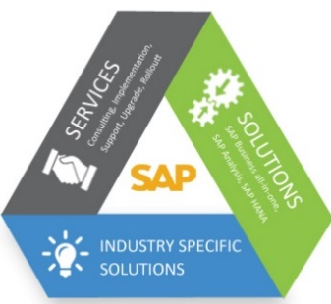
SAP Service Portfolio
Solution Discovery and Design
Business transformation consulting
Industry benchmarks and Best Practices
Business Process assessment
Global Delivery Model and
SAP Lifecycle Management tools
Plan
Implementations and Rollouts
SAP S/4HANA Global implementations & roll outs
SAP Fiori / UX deployment and Implementations
SAP BI / BO Analytics and EPM – BPC Implementations
Build
Upgrade, Enhance and Improve
SAP S/4HANA Migration
SAP S/4HANA Enterprise Management Deployment
SAP BW on HANA and BW4HANA migrations
Manage
Build and Manage
Applications Management Services
SAP Shared Services
Risk Reward Model
Catalogue Based Model
Improve
Application Portfolio Rationalization
Application roadmap
Application portfolio rationalization
SAP ERP led continuous business process improvements
Cloud Migrations
29-08-2019
www.lorhanit.com | © Lorhan IT 2019
www.lorhanit.com | © Lorhan IT Services 2019
10

Slide 11
SAP S4HANA Capabilities and Experience
Key facts and figures
SAP HANA Centre of Excellence
7 Suite on HANA and 20 S4HANA implementation projects globally with our first HANA implementation over 3 years ago
250+ S4HANA Professionals – Functional / ABAP / BASIS / Fiori
300+ Professionals trained in HANA globally
100+ HANA Use Cases identified for business functions and industries
S4 HANA implementation / Conversion Toolkit and accelerators
SAP HANA Center of Excellence at Hyderabad, India
  Proof-of-concept and pilot projects
  Define and execute road maps
  SAP showcase HANA capabilities in industry “Day-in-the-Life” scenarios, Technology demos
Preconfigured Solutions on S4HANA:
  Fully configured industry-specific SAP S4HANA Solutions with best practices, templates, assets, Test scripts and Tools
  5 industry solutions on S4HANA
  20 tested end-to-end scenarios
VALUE DISCOVERY WORKSHOPS
Innovation Workshops
S4HANA Roadmaps
Industry Use Cases
Day in the Life Scenarios
Technology Demos
SAP HANA PILOT’s
Proof-of-Concepts
Pilots
SME Support
HANA Performance Reviews
DELIVERY SUPPORT
Use Cases
Reuse of Assets
SME Support
Standardized Methodology
HANA Solution Factory at our Delivery Center in India
SAP HANA LAB
Global HANA CoE
SME Network
HANA Performance Reviews
Competency Building
Technology Evaluation
29-08-2019
www.lorhanit.com | © Lorhan IT 2019
www.lorhanit.com | © Lorhan IT Services 2019
11

Slide 12




















SAP FMCG Customers
29-08-2019
www.lorhanit.com | © Lorhan IT 2019
www.lorhanit.com | © Lorhan IT Services 2019
12

Slide 13
S/4HANA Digital Core Offering
          User Experience(UX) – Fiori
          Analytics
29-08-2019
www.lorhanit.com | © Lorhan IT 2019
www.lorhanit.com | © Lorhan IT Services 2019
13

Slide 14

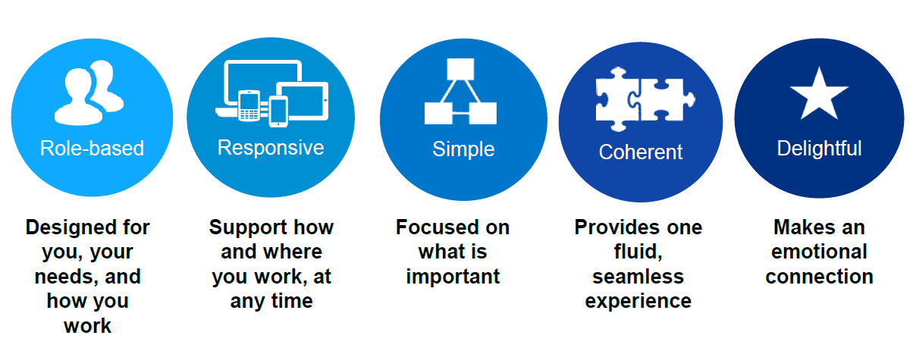
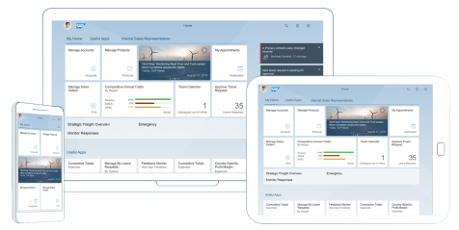
S/4HANA User Experience (UX) - Fiori
Sap fiORI
SAP Fiori 2.0 User Experience
Role-based
Adaptive
Simple
Coherent
Delightful
29-08-2019
www.lorhanit.com | © Lorhan IT Services 2019
www.lorhanit.com | © Lorhan IT 2019
14

Slide 15
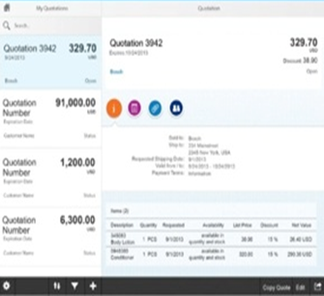
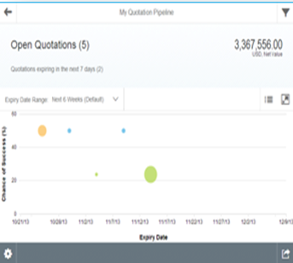
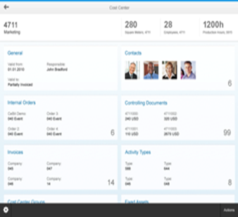
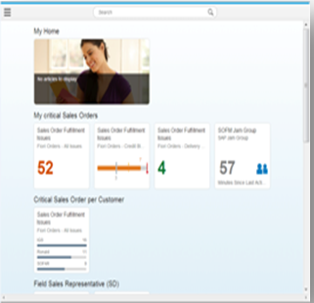
Fiori apps provide improved user handling, analytical functions and decision making basis for business
Transactional
Analytical
Factsheets
Smart Business Cockpits
Task-based access
Access tasks to create, change, approve processes with guided navigation
Insights
Get a visual overview of a complex topic for monitoring or tracking purposes
Search and explore
View essential information about an object with contextual navigation betw related objects
Insight to action cockpit
Analyze and evaluate strategic or operational KPIs in real time and trigger the right action
anyDB
SAP HANA
SAP HANA
SAP HANA
SAP HANA
29-08-2019
www.lorhanit.com | © Lorhan IT 2019
15

Slide 16
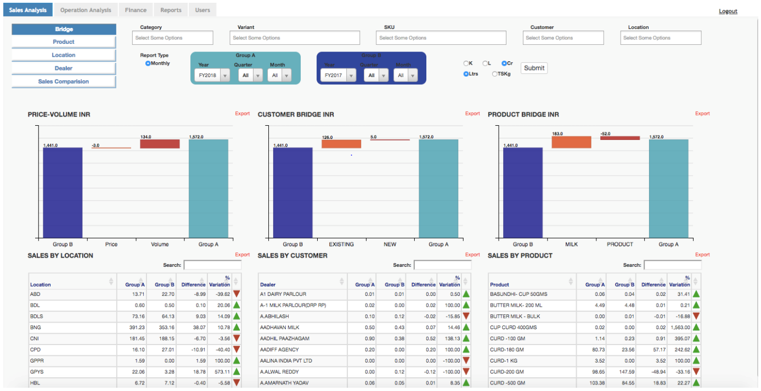
S/4HANA – Analytics Dashboard – Sales Analysis
29-08-2019
www.lorhanit.com | © Lorhan IT Services 2019
www.lorhanit.com | © Lorhan IT 2019
7

Slide 17
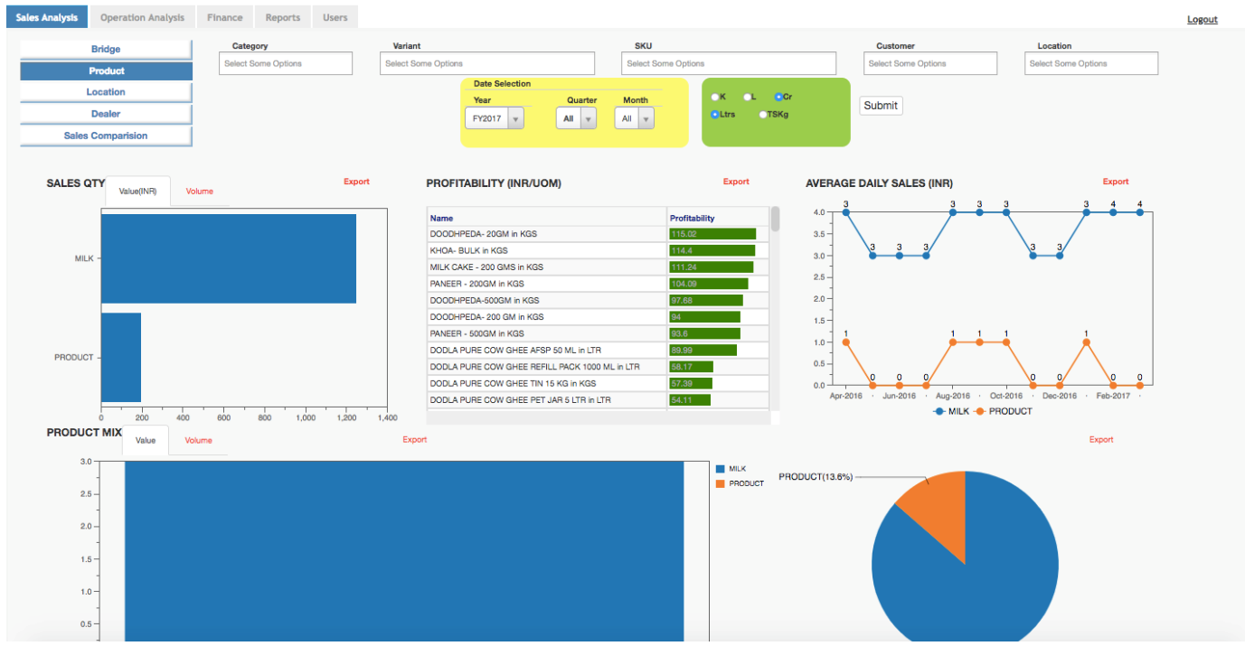
S/4HANA – Analytics Dashboard – Sales Analysis
29-08-2019
www.lorhanit.com | © Lorhan IT Services 2019
www.lorhanit.com | © Lorhan IT 2019
7

Slide 18
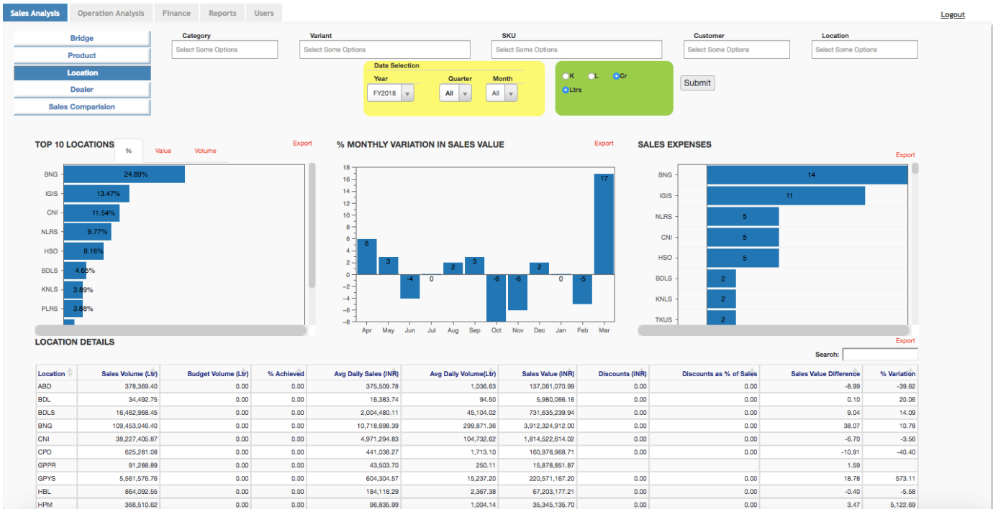
S/4HANA – Analytics Dashboard – Sales Analysis
29-08-2019
www.lorhanit.com | © Lorhan IT Services 2019
www.lorhanit.com | © Lorhan IT 2019
7

Slide 19
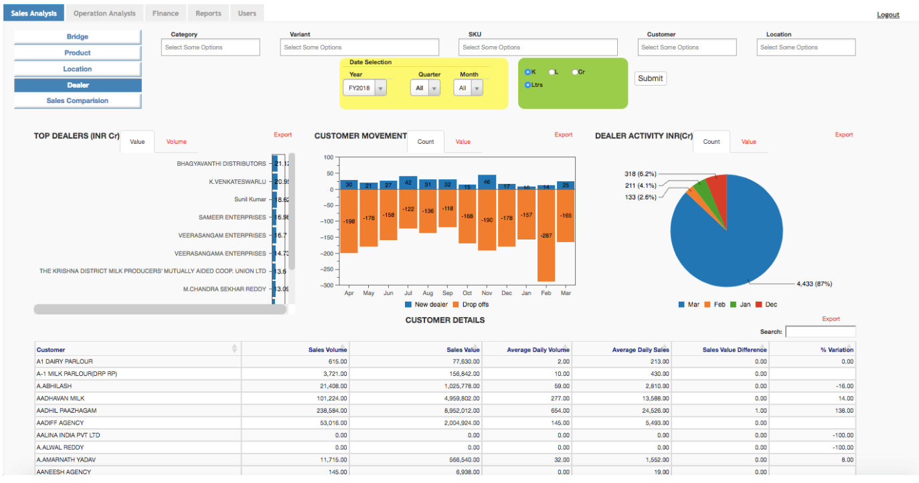
S/4HANA – Analytics Dashboard – Sales Analysis
29-08-2019
www.lorhanit.com | © Lorhan IT Services 2019
www.lorhanit.com | © Lorhan IT 2019
7

Slide 20
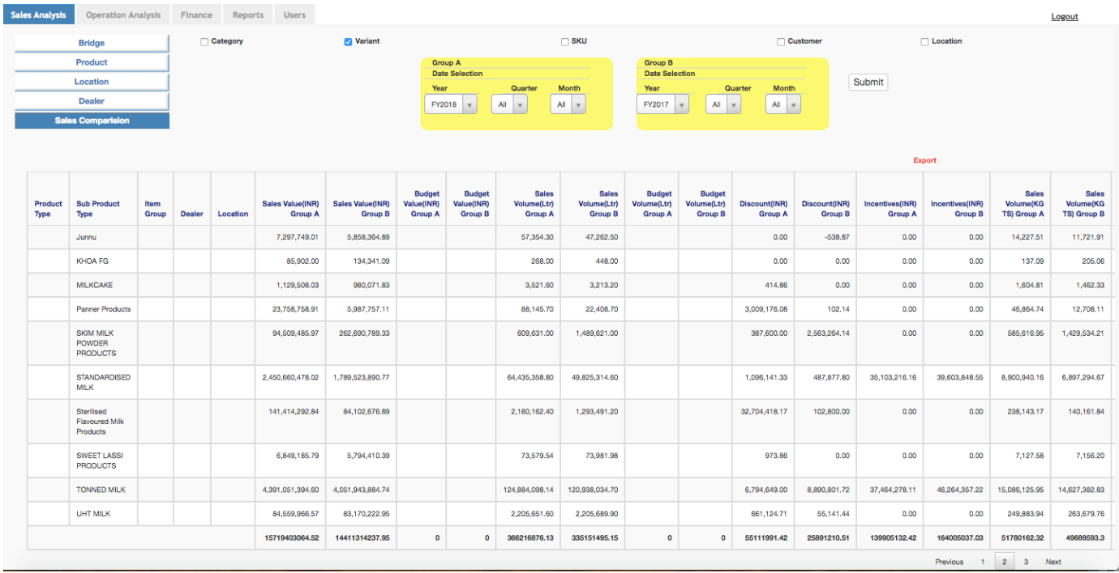
S/4HANA – Analytics Dashboard – Sales Analysis
29-08-2019
www.lorhanit.com | © Lorhan IT Services 2019
www.lorhanit.com | © Lorhan IT 2019
7

Slide 21
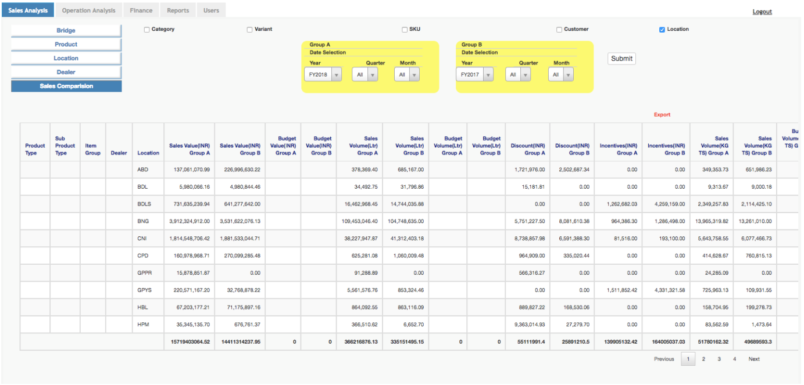
S/4HANA – Analytics Dashboard – Sales Analysis
29-08-2019
www.lorhanit.com | © Lorhan IT Services 2019
www.lorhanit.com | © Lorhan IT 2019
7

Slide 22
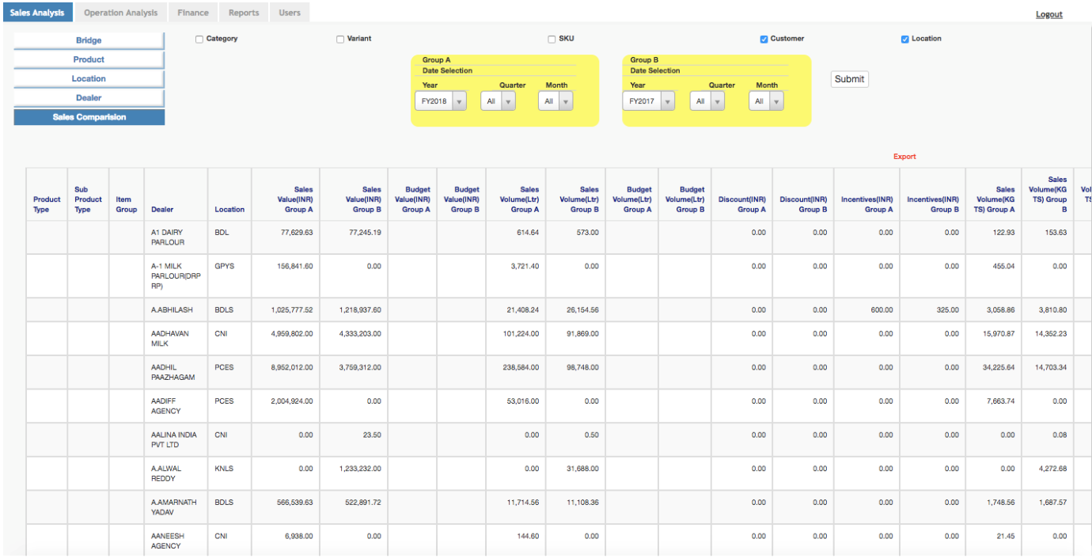
S/4HANA – Analytics Dashboard – Sales Analysis
29-08-2019
www.lorhanit.com | © Lorhan IT Services 2019
www.lorhanit.com | © Lorhan IT 2019
7

Slide 23
SAP S/4HANA Preconfigured Solution for Dairy Industry
29-08-2019
www.lorhanit.com | © Lorhan IT 2019
www.lorhanit.com | © Lorhan IT Services 2019
23

Slide 24
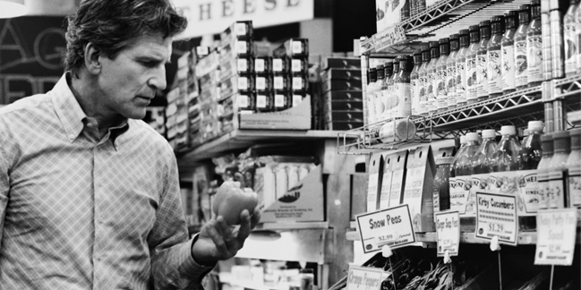
SAP S/4 HANA Preconfigured Solution for Dairy Industry
The Solution Focus
Our Preconfigured Dairy Solution Difference
A Solution designed to manage your Business
Developed to meet your unique needs and your Future plans
29-08-2019
www.lorhanit.com | © Lorhan IT 2019
www.lorhanit.com | © Lorhan IT Services 2019
24

Slide 25
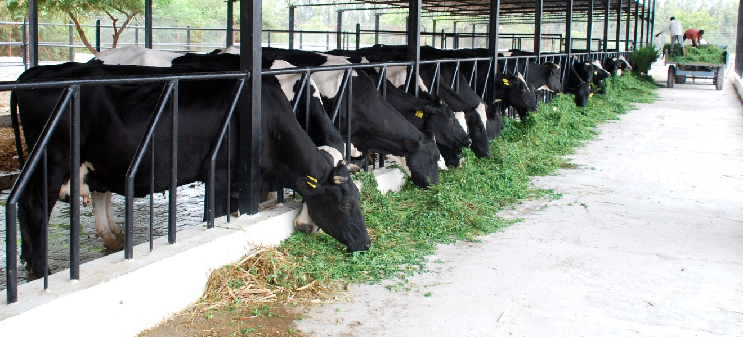
















Our SAP Journey in Dairy Industry
125 LPD
100 LLPD
75 LLPD
2018-19
52 LLPD
2015-16
49 LLPD
2014
18 LLPD
2012
2011
2010
  Connects 6,00,000 Farmers and Agents covering 1,00,000+ Villages procuring 125 + LLPD every single day
  LLPD : Lakh litres per day processed per Day
29-08-2019
www.lorhanit.com | © Lorhan IT 2019
www.lorhanit.com | © Lorhan IT Services 2019

Slide 26

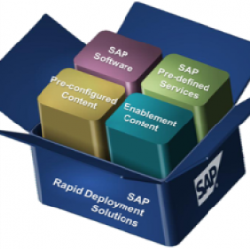
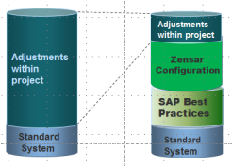
Innovative Solution Approach
15-20 % customizations: As every organization
operates in a unique way with unique business needs
Dairy 1
Preconfigured Dairy
Solution
80- 85 % of the daily business processes are embedded with our SAP Dairy Solution
Directly reduces the cost of implementation.
Replication of solution gives a 100 % security for project success.
Dairy 4
Dairy 2
.
Dairy 3
Plug and Play with only 15-20% delta Customization
29-08-2019
www.lorhanit.com | © Lorhan IT 2019
www.lorhanit.com | © Lorhan IT Services 2019

Slide 27

Key Solutions
Product Costing based on FAT & SNF
Daily Material Balance Gain and Loss Report
Tankers Management
FAT & SNF Reports for all Products
Each Process- Step by step Gain and Loss Details
Inventory Management
Crates and Cans Management
Quality Reports
Stocks Overview
Dispatches and Receiving of Tankers
Product Cost of Powder
Stocks of the Packing Materials
Sales Returns
29-08-2019
www.lorhanit.com | © Lorhan IT 2019
www.lorhanit.com | © Lorhan IT Services 2019

Slide 28
Key Solutions – Contd..
Every day Sales Reports
Customers Out standing
Partner function in sales
Shelf life Products Report
Asset Accounting
Planning for Packing Materials
Protect my profit margins?
Automate industries unique purchase?
Reduce my time-to-market?
See clearly through the company reports Intelligently?
Concentrate on growth avenues?
Attain maximum resource and system performance?
Understand and serve my customers better?
29-08-2019
www.lorhanit.com | © Lorhan IT 2019
www.lorhanit.com | © Lorhan IT Services 2019

Slide 29
SAP S/4 HANA Preconfigured Solution for Dairy Industry
The Solution Focus
Our Preconfigured Dairy Solution Difference
A Solution designed to manage your Business
Developed to meet your unique needs and your Future plans
29-08-2019
www.lorhanit.com | © Lorhan IT 2019
www.lorhanit.com | © Lorhan IT Services 2019
29

Slide 30
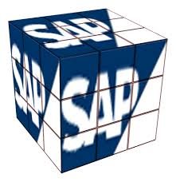
Solution Footprint
Procurement
Manufacturing
Quality Management
Sales and Distribution
Finance and Controlling
29-08-2019
www.lorhanit.com | © Lorhan IT 2019
www.lorhanit.com | © Lorhan IT Services 2019

Slide 31


Materials Management
Knowledge Management
Purchase Requisition
Supplier Payments
RFQ & Purchase Orders
Tendering
Supplier Collaboration
Supplier Evaluation & Blacklisting
Contract Management
Delivery Schedules
Quality Inspection
Physical Inventory Audits
ProMAN
Approvals & Workflows
Shelf Live & Status
Goods Movements
Service Masters
Warehouse Management
Workflows
29-08-2019
www.lorhanit.com | © Lorhan IT 2019
www.lorhanit.com | © Lorhan IT Services 2019
Notes:
31

Slide 32
Milk Procurement Cockpit - Features
Milk Procurement Process includes the Price Calculation based on the rate charts (for both Agents & Farmers)
Handles Exceptions Like NIL Payments and Unclaimed milk with approval process
Handles Milk Rejections and Extraneous Matter Details
Loans and Advances to agents with approvals, and calculation of eligibility amount , EMI calculation and automatic EMI recovery from the Milk payment
Automatic recovery of P&L (feed & medicines) amount from the milk Payment
Payment process to agents and Farmers at one go, as per the payment period, considers all recoveries like loans, advances and Other Recoveries
Agent and society farmer wise Bills
Captures Vehicle Movements(Truck Sheets) including Price Calculation , Information like distance, Qty of milk
Handles Transporter Penalties and Recoveries
Freight Vendors Payment Process considering all recoveries
Price Amendments Process, incase of Rate Change
Information of Milk procurement Survey, Supervisor Field Inspection and Complaint Logs details
Milk procurement specific reports for Daily monitoring
Integration of Legacy System to SAP system using Process Orchestration
Loss recovery incase of Farmers Collection Centre
29-08-2019
www.lorhanit.com | © Lorhan IT 2019

Slide 33

Increases Efficiency in Procurement
Challenges
Cope with ever-changing quantity and quality of the raw milk
Manage complex payment conditions
Cope with seasonal fluctuation
Create operational efficiencies & transparency
Our Dairy Solution Can Help You
Set up integrated and flexible processes for procurement
Streamline raw material collection and reception
Ensure integrated quality management
Batch Traceability
29-08-2019
www.lorhanit.com | © Lorhan IT 2019
www.lorhanit.com | © Lorhan IT Services 2019
33

Slide 34
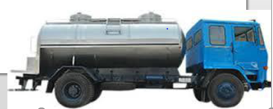
Our Dairy Solution - Stock Transfers
Raw Chilled Milk Transfer
Ability to Track the
Quantity and Quality Parameters at Sending and Receiving
Time of Issue and Receipt
Transporter Details , Route Distance and Delivery Cost : Freight ,Diesel Toll amount
Movement of Empty Vehicle from one Plant to another
Liability Generation to Transport Vendors for all trips at one go
29-08-2019
www.lorhanit.com | © Lorhan IT 2019
www.lorhanit.com | © Lorhan IT Services 2019
34

Slide 35
Our Dairy Solution - Stock Transfers
Raw Chilled Milk Stock Transfer
Ability to Track the
Quantity and Quality Parameters at Issue and Receipt
Time of Issue and Receipt
Delivery Cost : Freight ,Diesel Toll amount
Movement of Empty Vehicle from one Plant to another
29-08-2019
www.lorhanit.com | © Lorhan IT 2019
www.lorhanit.com | © Lorhan IT Services 2019

Slide 36
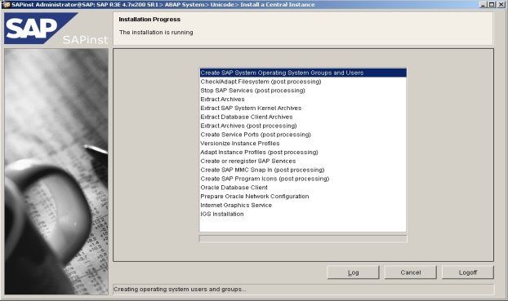
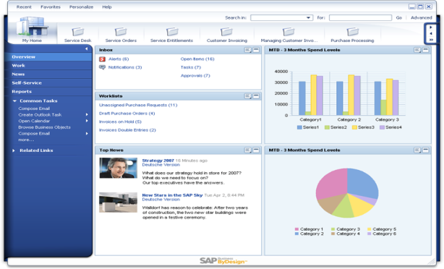
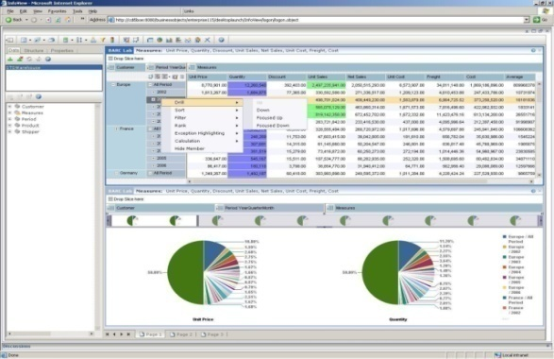
Production Planning and Control
Capacity Planning
Alerts
Demand Management
Reporting
MRP
Production Resource Tool
Costing
Work Center Management
Planning Strategies
Master Production Scheduling
Assemble To Order
Production Order Management
Sales Operation Planning
Confirmations
Project Production
LINE MANAGER
MRP CONTROLLER
PLANT MANAGER
29-08-2019
www.lorhanit.com | © Lorhan IT 2019
www.lorhanit.com | © Lorhan IT Services 2019

Slide 37
Our Dairy Solution – Manufacturing Process
User friendly screens in areas of Production and Stock Transfers to view Fat and SNF build up, to create batches and inspection lots automatically and loss and gain of quality Parameters of all batches.
Gain and Loss in terms of Fat & SNF for each batch produced (i.e. input /output).
Fat & SNF based costing of every product and that too batch wise .
Batch Management - has the ability to analyse top down and bottom up traceability for defect analysis to enable
targeted product recall. The tool provides the visibility of shelf life expiration and other usability differences and is
equipped to generate unique batch numbering.
Our Dairy solution is preconfigured for all the dairy Process like:
    Chilling Process , SMP Production
    Butter Production , Bulk Processing for Products(Ice Cream ,Curd ,Paneer ,Cheese and etc.)
    Rework process , Separation Process
    Standardisation Process ,Packing Process(Milk and Milk Products)
    Batch to Batch transfer process
    Stock transfers (Internal(Quality Check at Reception) and Market issues)
    Conversion Process
Dairy Production Reports for Daily Monitoring
Inventory accounting of FAT content across all milk products and process
Milk Material Balance - The tool considers all the receipts, issues and ingredients consumed during processing of the milk and
generate a report to give a distinct idea of the periodic performance of the plant on gain / loss % of FAT & SNF
29-08-2019
www.lorhanit.com | © Lorhan IT 2019
www.lorhanit.com | © Lorhan IT Services 2019

Slide 38
Optimize Manufacturing
Challenges
Base plans on a non-standardized raw material
Define optimal product mix
Create operational efficiencies and transparency
Optimize production
Our Dairy Solution Can Help You
Set up integrated and flexible processes for manufacturing
Monitor raw material utilization and losses
Ensure integrated quality management
Track batches
29-08-2019
www.lorhanit.com | © Lorhan IT 2019
www.lorhanit.com | © Lorhan IT Services 2019
38

Slide 39

Our Dairy Solution - QM Offering
  Complete price control on raw material receipt based on the quality parameters
  Batch Tracking based from top to bottom and bottom to top
  System controlled on low quality material usage to eliminate defects in the finished products
  Real-time visibility into customer demand on quality parameters and delivery of it
  Reduce inventory levels and improve the order fulfillment cycle
  Close monitoring of shelf life with the required alerts
  Enable targeted product recalls
  Compliant with all requirements of Food Safety Modernization Act (FSMA)
29-08-2019
www.lorhanit.com | © Lorhan IT 2019
www.lorhanit.com | © Lorhan IT Services 2019
39

Slide 40
Food Safety and Regulatory Compliance
Challenges
Align with food regulations (import/export)
Enable fast, effective product recalls
Track and trace
Our Dairy Solution can help you
Track, monitor, and trace batches and inventory
Streamline with procurement, production, and sales
Manage sales returns
Enable targeted product recalls
29-08-2019
www.lorhanit.com | © Lorhan IT 2019
www.lorhanit.com | © Lorhan IT Services 2019
40

Slide 41

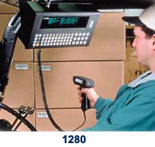
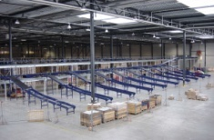

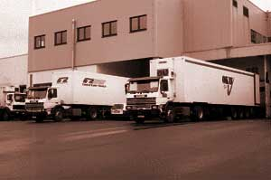

Sales and Distribution
External Contracts
Delivery Processing
Picking
Freight Costing
Packing
Transportation Billing / Payment
Goods Issue
Printing & Communication
Monitoring Transportation
Truck Load Definition
Planning / Monitoring / Analysis
Batch Management
Transportation Planning
Serial Number Management
Route Schedules
Pick Sort Pack Load Print Ship
29-08-2019
www.lorhanit.com | © Lorhan IT 2019
www.lorhanit.com | © Lorhan IT Services 2019

Slide 42
Our Dairy Solution - SD Offerings
Sales processes enabled for different types of customer groups - distributors/ Institutional/Parlours/Agents
Pricing models worked out based on backward pricing from MRP. Multiple levels of discounts / statutory taxes/ surcharges / freight /
payment terms is available
Route wise sales Interface – Trip Sheet for Handling the Dairy Industries mass sales process smoothly
  Route wise Trip Sheet Print
  Handles despatch of Milk and Crates to Agents Route wise
  Handles Cash and Check amount
  Stock check of the Truck Quantity and Despatched Quantity
  Handles Leakages/Shortages/Miscellaneous Quantity
  Approval process of the Trip Sheet after checking the Collection Amount
  Handles Inventory/ Customer Invoices
  Indents for Next day will be created automatically
  Auto Clearing of Customer Invoices on FIFO method
  Handles Returnable Crates
  Information Related to agents(Openings & Dues)
Scheme Process - Incentive calculation done based on volume / value/Slab Base for each transaction without manual intervention for period/Quarterly and automatic adjustment of quantity in Orders
Procurement and Input Process for distributing of goods to the agents
Integration with Hand held device
29-08-2019
www.lorhanit.com | © Lorhan IT 2019
www.lorhanit.com | © Lorhan IT Services 2019

Slide 43

Our Dairy Solution - SD Offerings
Handles Returnable Packaging
Direct Store Delivery (Trip Sheet)
Transport Management
Integration with Hand held device
Integration with POS
Integration with customer legacy systems
29-08-2019
www.lorhanit.com | © Lorhan IT 2019
www.lorhanit.com | © Lorhan IT Services 2019
43

Slide 44
Improve Sales Efficiency
Challenges
Protect market share
Meet retailer requirements
Improve sales force productivity
Get visibility in the sales process
Get closer to the customer
Our Dairy Solution Can Help You
Plan, track, control, and optimize sales performance
Expand service processes
Strengthen collaboration with partners and key customers
Track indirect sales and customers
Ensure correct handling of rebates
29-08-2019
www.lorhanit.com | © Lorhan IT 2019
www.lorhanit.com | © Lorhan IT Services 2019

Slide 45

Our Dairy Solution – FICO Offerings
Meeting local legal and fiscal requirements
Improving administrative activities efficiency
Complex payments to Producers
Product costing and profitability
Maintaining focus on most profitable customers and brands
Implement an enterprise resource planning (ERP) solution fully compliant and continuously updated with local legal and fiscal requirements
Improve efficiency in accounting activities due to a seamless process integration across the business that eliminates double-checks and redundancies
Enhance company profitability analysis through profit and loss calculation by customer and brand
29-08-2019
www.lorhanit.com | © Lorhan IT 2019
www.lorhanit.com | © Lorhan IT Services 2019

Slide 46
Our Dairy Solution - FICO Offerings
Tightly integrated with Milk Procurement, Purchase, Sales and Production process
FAT and SNF based inventory valuation considering all the costs incurred
Product Cost Apportionment using FAT & SNF quality Parameters
DME file Generation for different Banks for Milk Procurement Vendor Payments
Accounting Route wise Cash / Cheque collections and Clearing Process
Freight Vendors payments Primary and Secondary
Payment Advice and Cheque Printing
Profitability analysis is available at Product wise /Customer wise / Segment wise
Indian Taxation, GST
Better manage fixed assets, calculate depreciation (as per IT act and as per Company Act) as required
Sub-ledgers are fully integrated with main ledger and real-time information for receivable and payables is available
29-08-2019
www.lorhanit.com | © Lorhan IT 2019
www.lorhanit.com | © Lorhan IT Services 2019
46

Slide 47
THANK YOU!
WE LOOK FORWARD TO WORKING WITH YOU!
M.Y.Maharshi
Managing Director
MYM Technologies Limited
Flat No:102,Shreya Blossoms, Road no.15/A Jubilee Hills,
Hyd-500033
Email id: maharshi@mymtechnologies.com
Mobile:+91 9849004856
www.lorhanit.com

